Slide 1
Icebergs, Bathtubs & Flows
Applying Systems Thinking to Software Architecture
Matt McLarty, Global Leader of API Strategy at MuleSoft, a Salesforce company
@mattmclartybc

Slide 2
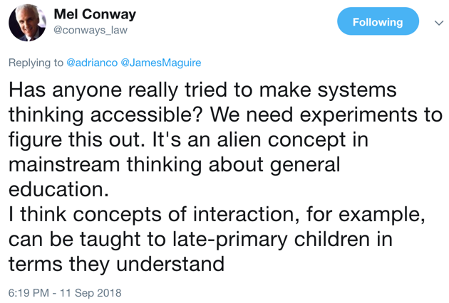
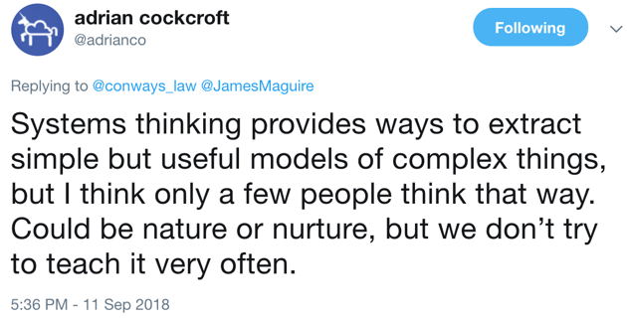
Inspiration

Slide 3
Software architecture
…is a study in dealing with complexity
Functional
Operational
Organizational

Slide 4
What is “systems thinking”?
A conceptual approach to problem solving that considers the behaviour, structure, and interconnected parts of the complex systems within which the problem occurs
Related to systems theory, systems engineering, system dynamics, and chaos theory

Slide 5
Thinking in Systems
A system is greater than the sum of its parts
A system cannot be controlled
Systems can be understood and influenced
“Systems fool us by presenting themselves—or we fool ourselves by seeing the world—as a series of events.”
Donella “Dana” Meadows
http://donellameadows.org/donella-meadows-legacy/danas-writing/

Slide 6
Stocks & flows
Stock
Flows

Slide 7
Time graphs

Slide 8
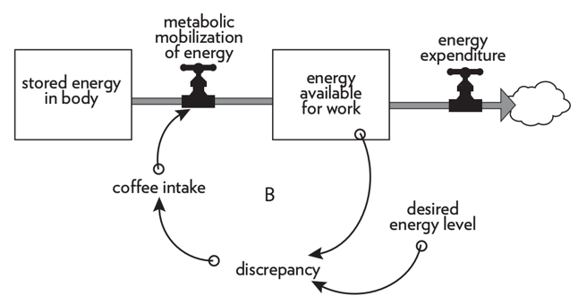
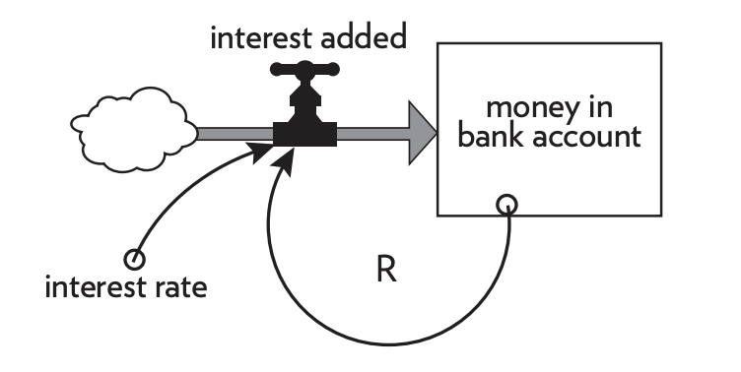
Feedback loops
Balancing Loops
Reinforcing Loops

Slide 9
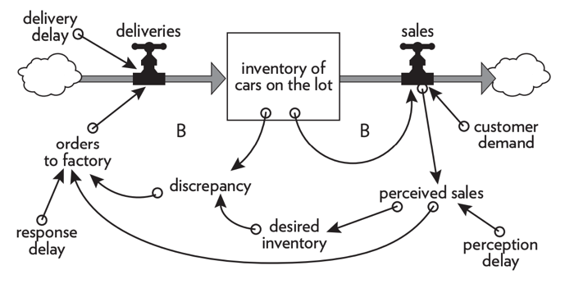
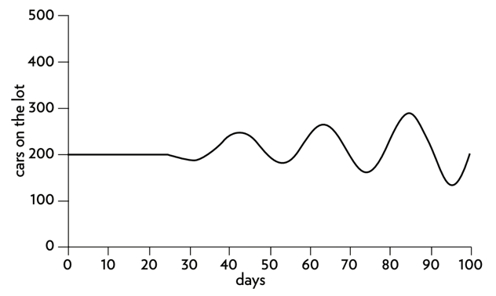
Delays and oscillations

Slide 10
System dynamics
From https://thesystemsthinker.com/step-by-step-stocks-and-flows-converting-from-causal-loop-diagrams/

Slide 11
Understanding systems
What?
Events show that there is a system
How?
Patterns show its behaviour
Why?
Structure begins to show its purpose

Slide 12
Iceberg model
Event
Pattern
Mental Model
Structure

Slide 13
System boundaries
All system boundaries are artificial
If they are set too small, they are error prone
If they are set too large, they are difficult to analyze
Boundaries should change over time as the problem changes
“Where to draw a boundary around a system depends on the purpose of the discussion.”

Slide 14
Highly-functioning systems
Resilience
Self-organization
Hierarchy
The ability of the system to maintain its purpose through destabilizing events
Balancing loops for balancing loops
The ability of subsystems to change themselves
How the system makes itself more complex
Not about power structures
About abstraction to simplify communication between components
“Stable intermediate forms”

Slide 15
System archetypes
Policy resistance
Tragedy of the commons
Drift to low performance
Escalation
Success to the successful
Addiction
Rule beating
Seeking the wrong goal

Slide 16
Leverage points
Improving the information flow
Changing rules and authority
Increasing self-organization
Changing goals and purpose
Shifting the paradigm

Slide 17
The Fifth Discipline
Learning Organization
Aspiration
Generative Conversation
Understanding Complexity
Personal Mastery
Shared Vision
Mental Models
Team Learning
Systems Thinking

Slide 18
The Art of Systems Architecting
Analysis of different types of systems, including software systems and collaborative systems
Applies heuristics and design progression
“It is the system, not the software inside, the client wishes to acquire.”
“The greatest leverage in system architecting is at the interfaces.”
https://sdincose.org/wp-content/uploads/2017/10/TheArtOfSystemsEngineering_inaugural.pdf

Slide 19
Applying systems thinking
…to software architecture…

Slide 20
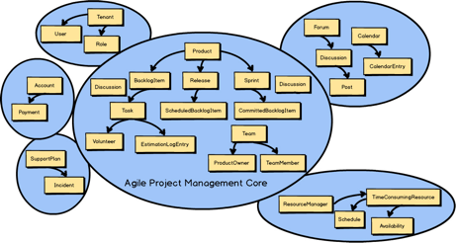
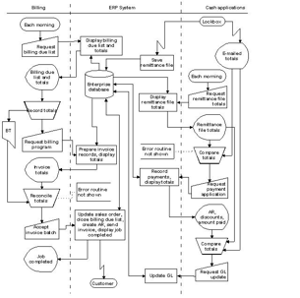
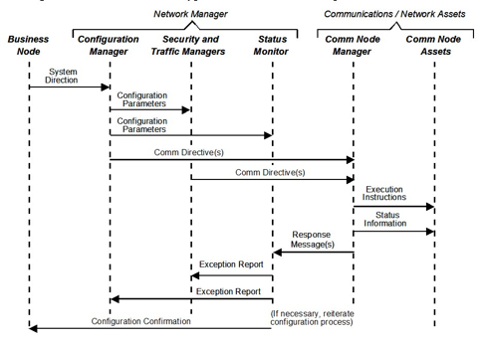
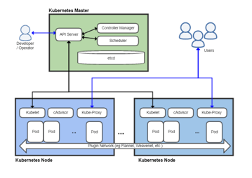
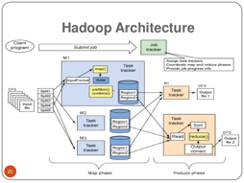
Software systems

Slide 21
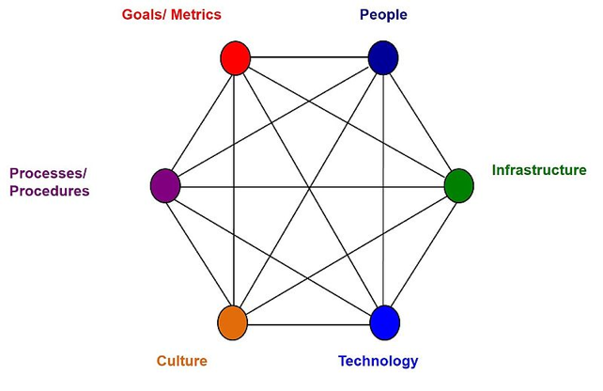
Software systems
…are sociotechnical systems

Slide 22
What is software?
Software is a digital projection of human intentions
Software architecture should focus on aligning those intentions toward a common goal

Slide 23
System archetype: “addiction”
Shifting the burden to the intervenor
“Addiction is finding a quick and dirty solution to the symptom of the problem, which prevents or distracts one from the harder and longer-term task of solving the real problem”
In software systems, this is “silver bullet” syndrome

Slide 24
Architectural leverage points
Transcending paradigms
Shifting the paradigm
Changing goals and purpose
Increasing self-organization
Changing rules and authority
Improving information flows
Limiting reinforcing feedback loops
Strengthening balancing feedback loops
Shortening delays
Optimizing stock-and-flow structures
Buffering stabilizing stocks relative to flows
Applying constants and parameters
…should be spent here!
Lots of time spent here…

Slide 25
Highly-functioning IT
Brittle monoliths
Resilient microservices
Self-organizing, cross-functional teams
Siloed organizations
Horizontally-tiered applications
Hierarchical domains, APIs

Slide 26
Stable intermediate forms
“Minimum viable product” approach

Slide 27
Leverage points scenario
ST3, Inc. – A diversified, multinational enterprise
For consistency, enterprise architecture has issued a standard to use DDD and API-fronted microservices for all development
Product teams slow in adopting, complaining that this is a bottleneck
EA has tried to fix with…
Architecture review process, escalation to CIO
Enterprise API design specification, with automated compliance checking
Development of enterprise domain taxonomy

Slide 28
System Archetype: “Policy resistance”
“When various actors try to pull a system stock toward various goals, the result can be policy resistance. Any new policy, especially if it’s effective, just pulls the stock farther from the goals of other actors and produces additional resistance, with a result that no one likes, but that everyone expends considerable effort in maintaining.”
AKA Newton’s Third Law of Systems

Slide 29
Using leverage points
“People deeply involved in a system often know intuitively where to find leverage points, more often than not they push the change in the wrong direction.”

Slide 30
Using leverage points
Transcending paradigms
Shifting the paradigm
Changing goals and purpose
Increasing self-organization
Changing rules and authority
Improving information flows
Limiting reinforcing feedback loops
Strengthening balancing feedback loops
Shortening delays
Optimizing stock-and-flow structures
Buffering stabilizing stocks relative to flows
Applying constants and parameters
Reduced team autonomy
Levered rules in the wrong direction
Tried to impose new structure

Slide 31
Using leverage points
Improve information flow
Communicate the mission; provide education and tooling on DDD concepts, practical microservices principles, and API design
Change rules and authority
Relax standards to focus on interoperability concerns, introduce optional guidelines, change review process to consultation
Increase self-organization
Create a community of practice where individuals from product teams can provide input to standards and guidelines
Change goals and purpose
Elevate the purpose from "consistency" to goals that help product teams: delivery speed, reduced coordination, technical debt removal
Shift the paradigm
Redefine product team's perception of enterprise architecture as an ivory tower cost center to a thoughtful and helpful change agency

Slide 32
System dynamics scenario
ST3, Inc. – A diversified, multinational enterprise
IT organization struggling to keep pace with customer needs
Product backlogs growing, delivery velocity slowing, releases failing
Have tried to fix with…
More thorough release reviews
Automated testing to allow for more features per release
Most experienced resources assigned to all major releases

Slide 33
Iceberg model: ST3 software delivery
Event
Pattern
Mental Model
Structure
Latest software release failed and could not be backed out
3 of last 4 major releases failed, prolonged recovery
Releases happen less frequently, with more features in each one
Lack of trust in production changes

Slide 34
System dynamics: ST3 software delivery
Unstable!
Too slow!
Too Expensive!
Product Backlog
Features in Production
Product Revenue
Operating Costs
Production Releases
Cost per Feature
S
Active Monthly Users
Release Complexity
S
Release Failure Rate
O
S
Customer Satisfaction
S
R
S
Features in Release
Perceived Risk of Production Changes
O
S
DELAY:
Release Frequency
S
O
Lack of Trust in Production Changes
Depth of Release Review

Slide 35
System dynamics: ST3 software delivery
Operating Costs
Product Backlog
Features in Production
Product Revenue
Production Releases
Cost per Feature
S
Active Monthly Users
Release Complexity
S
Release Failure Rate
S
S
Customer Satisfaction
S
R
S
Features in Release
O
Pressure to reduce release size
O
S
Perception of minimum viable release
Release Frequency
O
S
Lack of Trust in Big Production Changes
Release Size Assessment

Slide 36
Where to apply systems thinking
Not everywhere!
Systemic issues
Issues that won’t go away
Issues that get worse the more you try to fix them
“Paradigm shifting” changes in technology or approach

Slide 37
For more information…
Donalla Meadows resources
Rechtin & Maier book
Peter Senge & SoL
Systems Thinker website
Follow @archithinkery
https://thesystemsthinker.com/
http://donellameadows.org/
https://www.crcpress.com/The-Art-of-Systems-Architecting/Maier/p/book/9781420079135
https://www.solonline.org/
https://twitter.com/ArchiThinkery

Slide 38
What’s with the t-shirt?
TechLit Africa is a non-profit organization that helps African students learn the web by setting up labs in schools that have no internet access.
Site: https://techlitafrica.org
Donate: https://www.gofundme.com/building-computer-labs-in-african-schools
Hear Nelly Cheboi’s story on the Software Engineering Daily podcast here: https://softwareengineeringdaily.com/2019/05/20/emergingmarkets-kenya-with-nelly-cheboi/

